Slide 1
Grant Monitor Demo Day
Sprint 3
Daron Adams, Ken Schnarrs, Alex Iliev, Chase Rumfelt
Daron and Sons Software Development Co.

Slide 2

Sprint 3 Goals
Achieved Goals
Meet with our client so that we can get feedback on features we have implemented so far and ask for feedback on wireframes related to the show page. (Asked questions regarding certain features)
Looked into which users should be allowed into the website (Changed it where the app will only have 1 user)
Got the calendar component working
Redesigned the overall layout of the grant dashboard page
Populated grant dashboard with data from the database instead of data being hardcoded
Made a progress bar for the grant dashboard page that accurately displays the progress in terms of time
Made a progress bar for money spent on a grant
Added a feature to the grant dashboard page to allow a user to download data as a CSV or Excel file
Added filter functionality to the export feature where only filtered rows would be exported if a filter was applied and all rows if no filter was applied.
Added a feature to the grant dashboard page to allow a user to remove and re-add column from being viewed
Added a global filter button to the grant dashboard page for convenience
Implemented final database schema into the backend
Fixed the API issues and made additions/changes wherever necessary
Created a show page for a grant through the use of a modal. (When a user clicks on a row containing a grant it takes them to a subpage that allows a user to view information about that specific grant)
Made tabs that allow a user to transition to the different subpages a grant show page would contain
In Progress / Not Completed Goals
Work on allowing the user to create a grant
Work on allowing the user to edit the info of an existing or newly created grant
Work on deleting a grant
Make start and end date come from database in terms of the calendar component
Work on the ingesting of forms
Goals That Were Scrapped/ Not Start
Addition of JWT Tokens to the backend in relation to the current user. (Completed, but scrapped)
When on a show page for a grant, pages will need to be made for the employee, budget, labor, and effort reports. These reports will need to be able to be exported. (Changed our delivery of this information, handled on subpage tabs)
Add A Pie Chart visual so that transaction/balance can be viewed

Slide 3
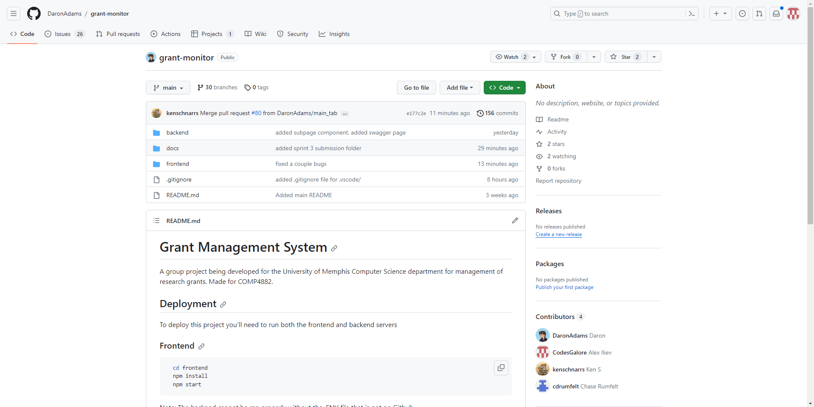
Live Demo of Our Code

Slide 4
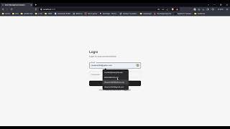
Think Aloud Sprint 3
Feedback from the Finch Team
When it came to the second go-around for the think aloud, we again did it with the Finch Team and like last time we think that it went pretty well. We were able to show a lot more features this time around and The Finch Team mentioned that they really liked the new design of the dashboard as it looked really clean and were a big fan of the column button in the toolbar and the transition tabs of the Grant Show Subpage. Furthermore, they appreciated the added export functionality which allowed them to download the data from the grant dashboard in two different ways while taking into account whether rows were filtered or not. One recommendation the Finch Team had for us had to do with the global filter button in the toolbar as they felt a little confused by the component at first and believe that it could be improved by adding a drop down menu for the value you would like to filter by instead of typing it. From this think aloud, the Finch Team was also able to encounter an error with the filtering feature which we were able to fix afterwards.
However, for the next think aloud we hope to have features such as creating and editing a grant working as well as all of the report functionality that deals with a specific grant so that a user can feel like they are directly interacting with our web app with data that they made and while also maintaining a greater understanding of the managing of grants.

Slide 5

Sprint 4 Initial Goals
Get all of the Grant CRUD components in a state where they can all be accessed and tested by a user
Work on all of the different type of reports (budget, employee, labor, effort reports)
Work on the ingesting of forms
Work on the Transaction Subpage for a Grant and overall transaction system
Make the calendar and chart components use data from the database
Add a Pie Chart component so that a visual can be established when it comes to transactions and balance
Set up a meeting with our client where she can directly interact with our website. (Think Aloud)

Slide 6


